Slide 1

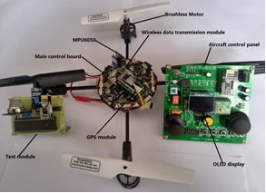
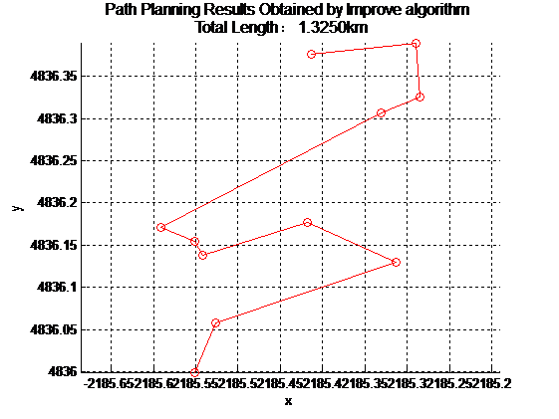
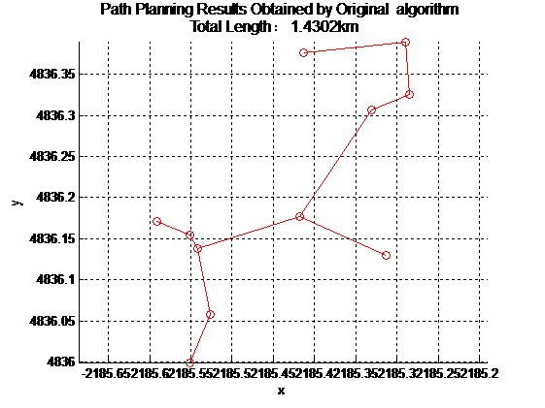





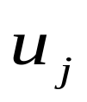
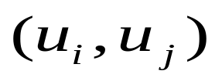
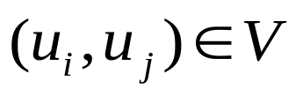

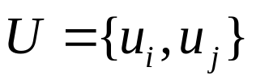

Improved Prim Algorithm and Its Application in Unmanned Aerial Vehicle Cruise System
May 28-30, 2017, Chongqing, China
PID: TueBIS-32
Funa Zhou¹, Po Hu^{1,}*, Xiaoliang Feng² ,Yansui Song³
School of Computer and Information Engineering, Henan University, Kaifeng, China
College of Electrical Engineering, Henan University of Technology, Zhengzhou, China
College of Automation, Northwestern Polytechnic University, Xian, China
1. Introduction
An important application of Unmanned Aerial Vehicle(UAV) is to implement the reconnaissance mission in forest fire protection, public safety, etc. A good cruise path can not only reduce the cost of executing the reconnaissance task, but also reduce its risk. The cruise path for UAV is usually planned by the methods of static planning or dynamic planning. Dynamic programming is based on static programming, so static programming is concerned in this paper. An improved Prim algorithm is studied by introducing constraint condition to improve the effect of UAV path planning. Based on the data provided by GPS module, the weight matrix between the target points is obtained by using coordinate transformation, and the optimal cruise sequence is obtained by using the improved Prim algorithm. Simulation results and success application in cruise path planning of UAV show the efficiency of this improved Prim algorithm. The improved algorithm be regarded as a more effective algorithm.
2. Prim algorithm
Prim's algorithm is used to construct the minimum spanning tree of a graph. It constructs the minimum spanning tree by connecting vertexes one by one. Basic idea of Primer algorithm is described as follows. Starting from a vertex u₀ in the connected graph G = (V, {E}), the minimum weight edge(u₀,u₁) associated with it is selected and its vertices are added to the vertex set U of the spanning tree. Each step is then selected from the edges (u, v) whose vertices are included in U and the other vertices are not. The edges are added to the edge set TE of the minimum spanning tree, while the other vertices are added to the set U. Repeat this process until all vertices are added to the vertex set U of the spanning tree.
Add the edge found in previous step to the set TE. If the number of edges is less than n-1 (where n is the number of vertices), turn to the previous step. If the number of edges is equal to n-1, the shortest path planning is completed.
4. Simulation and Analysis of the Proposed Algorithm
In order to test the validity of this algorithm, 10 different cities are selected and each city randomly selects multiple target points for analysis. The city A (Kaifeng city) to be cruised target points. The experimental platform we developed is shown in Fig.1. The planning result obtained by improve algorithm is shown in left picture of Fig.2, and the planning result obtained by original algorithm is shown in right picture of Fig.2. The coordinates of other N points to be visited in other cities are only used in MATLAB simulation of cruise path planning. The purpose of this section is to test the effectiveness of the path planning method developed in this paper.
Fig. 1. Experimental Platform
3. Improved prim algorithm
The improved algorithm is described as follows.
  Constructing Process of minimum spanning tree based Prim Algorithm
    Initialize
    From the constructed edges constituted by any
    an edge(u₀,v₀) with the least weight value can be found, then add it to TE , and take v₀ into U .
    If U=V, then turn to next step, otherwise go to previous step.
    Therefore, in the spanning tree , there must be an edge-set TE including n-1 edges, T is the minimum spanning tree of the connected graph G.
  Traverse all edges to find the edge with smallest weight, add the vertex and into the set of vertices U. Where , and so the set of edge .
  Taking the vertex and in the set as the search starting point. If there is any vertex degree of the minimum spanning tree T is greater than 2, deletes all edges connected to the vertex except for the two edges with the smallest weight values. Otherwise, turn to next step.
  Find an edge that is connected by vertices with degrees less than 2, which has the least weight. Before adding this edge to the set TE , check whether a loop is formed. If a loop is generated, the edge is discarded. Then continue to find the next smaller edge. Otherwise perform the next step.
Fig. 2. Planning Results Obtained by Improve and Original Algorithm
The complexity of different path planning algorithm is compared in Table 1, the effectiveness of the algorithm is evaluated by the total length of the path, easy see that the improved algorithm is comparable with the original algorithm in the sense of time complexity. Although the algorithm execution time is slightly increased, the accuracy of the algorithm solution is significantly improved. The improved algorithm can be regarded as a more effective algorithm.
Table 1. Complex Comparison of Different Algorithm.
algorithm name | time complexity | Average time of algorithm (s) | Error rate of algorithm (%)
Original |  | 1.2694 | 14.627
Improved |  | 1.3685 | 1.312
5. Conclusion
An improved Prim algorithm is studied by introducing constraint condition to improve the effect of UAV path planning. Simulation result and success application in cruise path planning of UAV show the efficiency of this algorithm.
Contact email: hupo4210@163.com

